Slide 1
Design and Analysis of Algorithms
Lectures Week 1 & 2

Slide 2
Outline Topics of the Week 1 & 2
Introduction
Fundamentals of algorithmic problem solving.
Important problem types.
Fundamental data structures.
Fundamentals of the analysis of algorithm efficiency
The analysis framework.
Asymptotic notations and basic efficiency classes,
growth of functions.

Slide 3
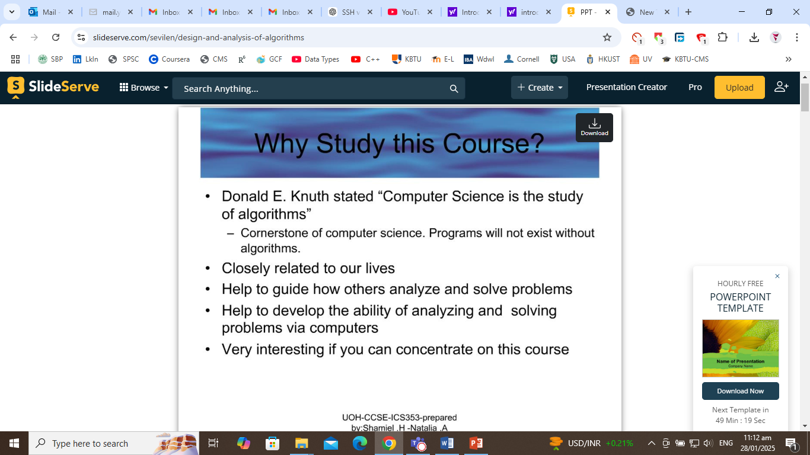

Slide 4
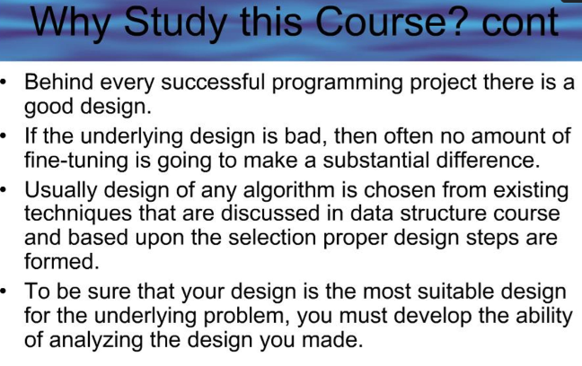

Slide 5
ALGORITHM
A sequence of unambiguous instructions for solving a problem, i.e. for obtaining the required output for any legitimate input in a finite amount of time

Slide 6
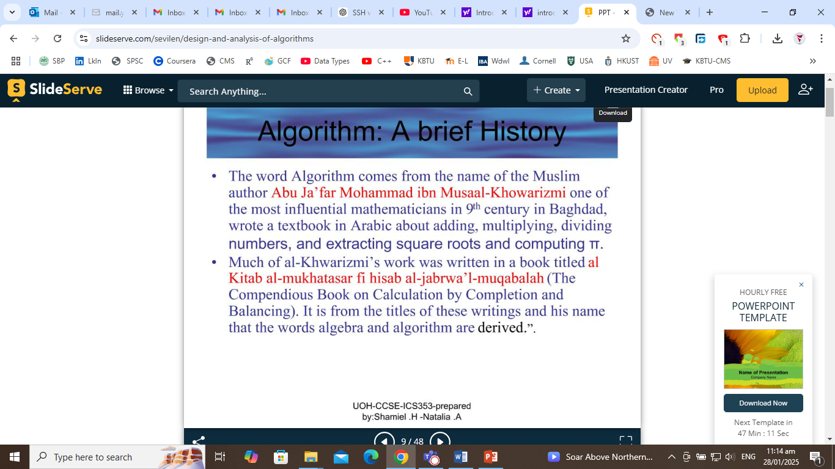

Slide 7
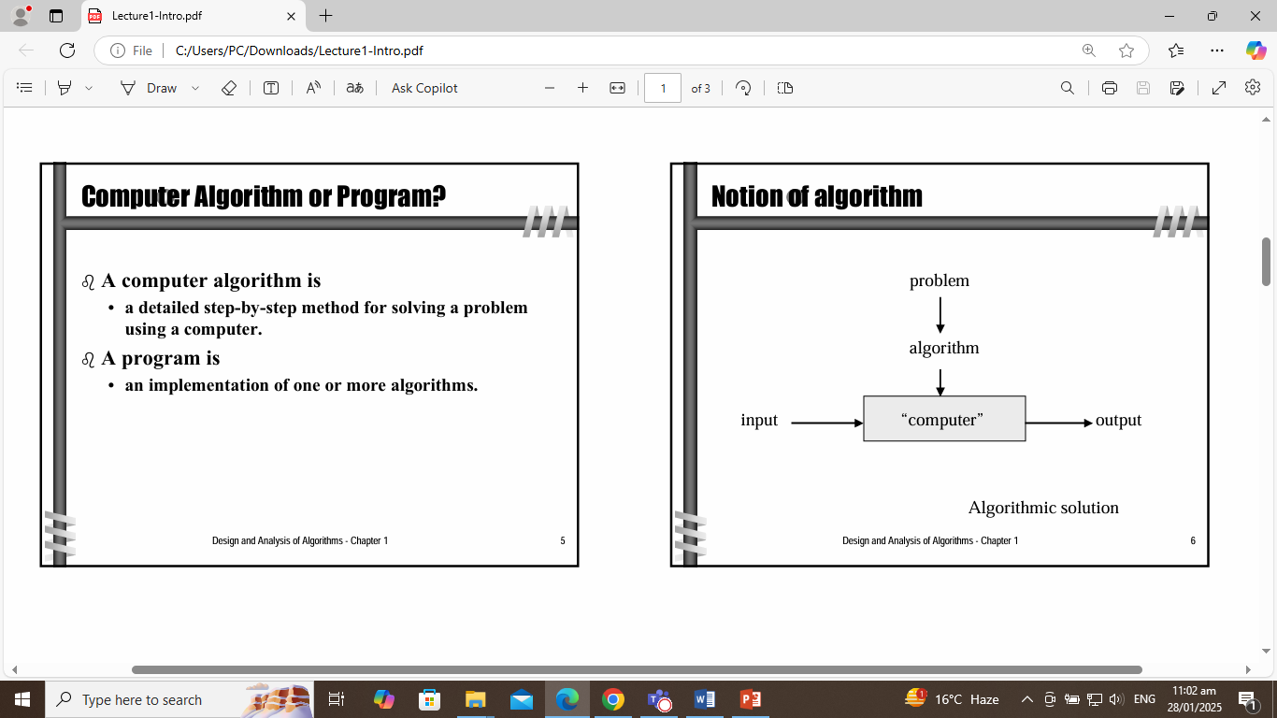

Slide 8
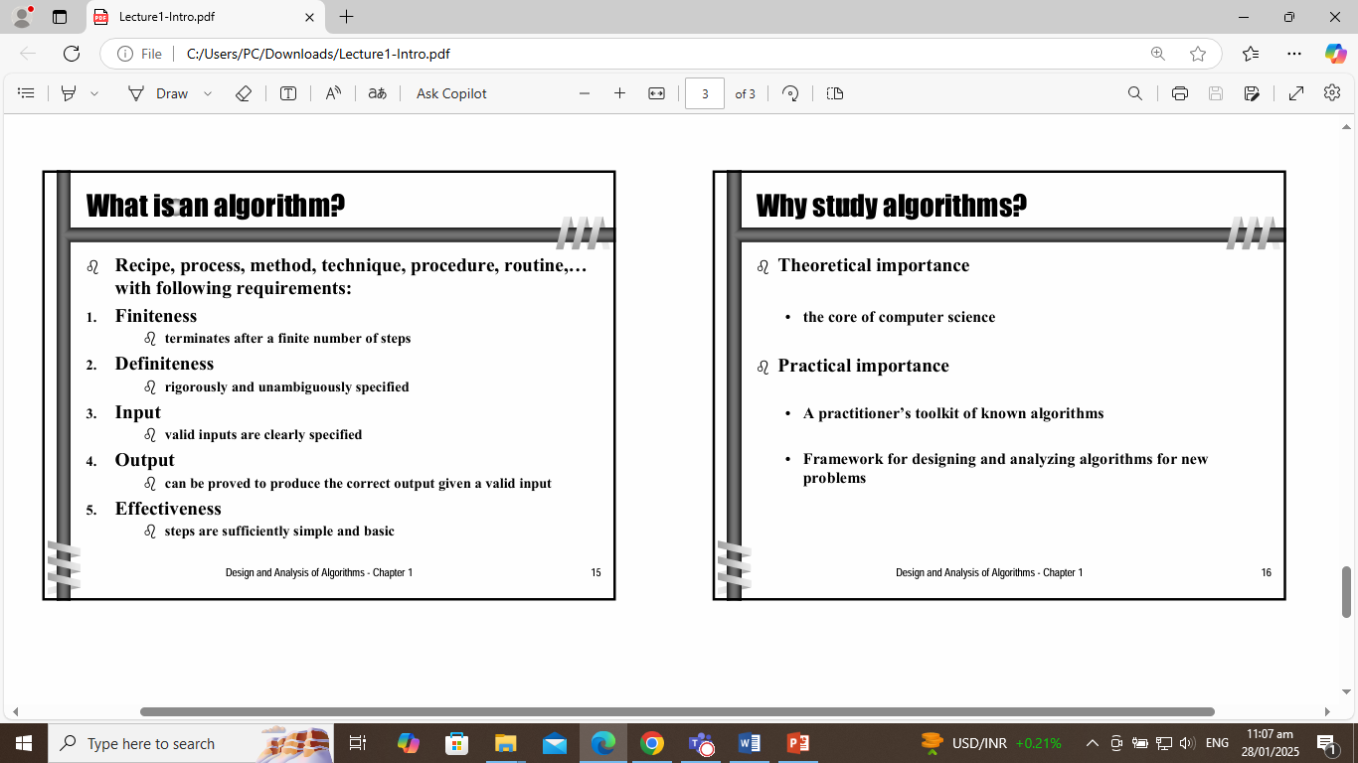

Slide 9
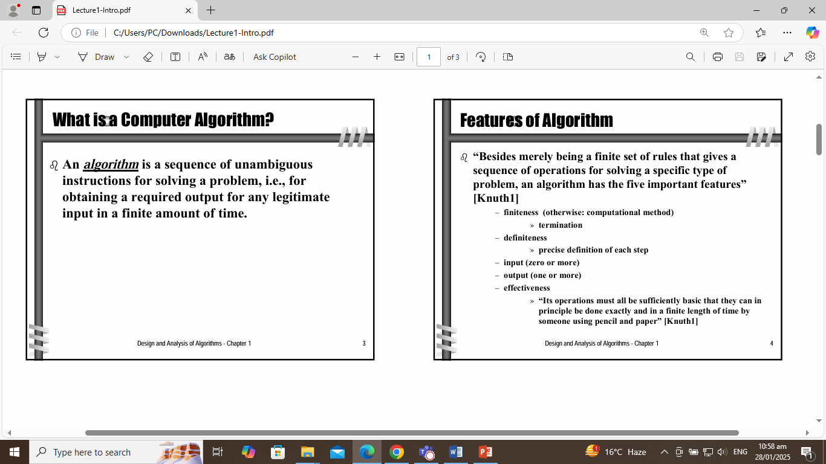

Slide 10
Important points
Non-ambiguity
Range of inputs
The same algorithm can be represented in different ways
Several algorithms for solving the same problem

Slide 11
Understand the problem
Decide on computational means
Exact vs approximate solution
Data structures
Algorithm design technique
Design an algorithm
Prove correctness
Analyze the algorithm
Code the algorithm

Slide 12
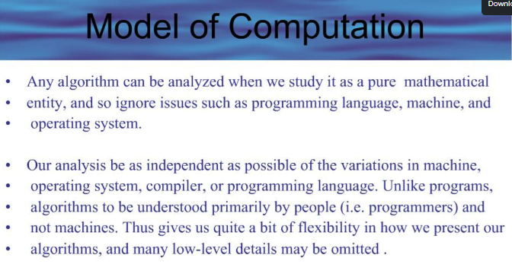

Slide 13
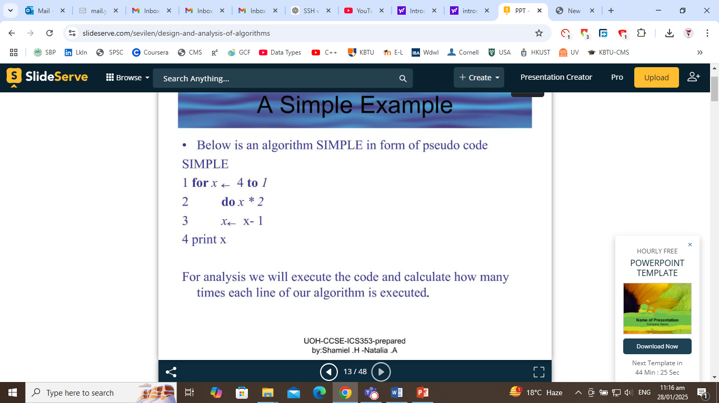

Slide 14
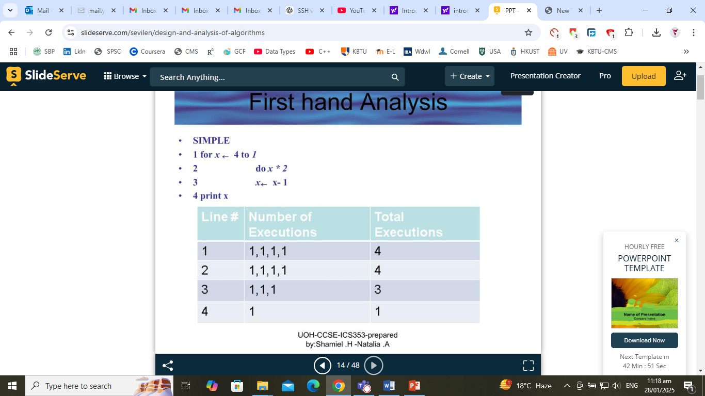
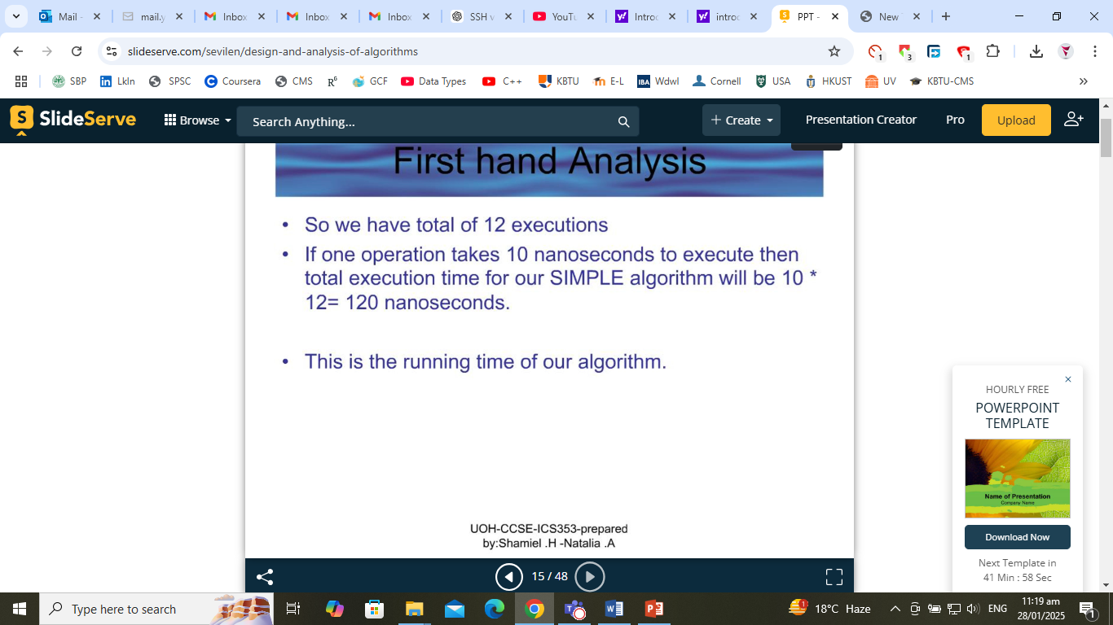

Slide 15
What does it mean to understand the problem?
What are the problem objects?
What are the operations applied to the objects?
Deciding on computational means
How the objects would be represented?
How the operations would be implemented?

Slide 16
Design an algorithm
Build a computational model of the solving process
Prove correctness
Correct output for every legitimate input in finite time
Based on correct math formula
By induction

Slide 17
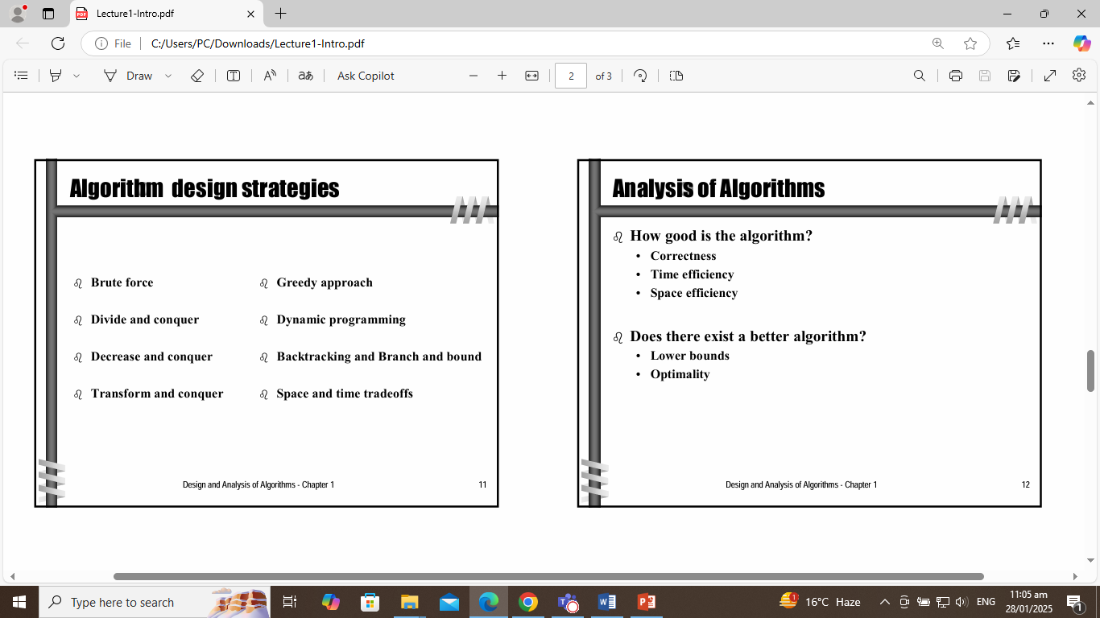

Slide 18
Analyze the algorithm
Efficiency: time and space
Simplicity
Generality: range of inputs, special cases
Optimality:
no other algorithm can do better
Coding
How the objects and operations in the algorithm are represented in the chosen programming language?

Slide 19
Important problem types
Sorting
Searching
String processing
Graph problems
Combinatorial problems
Geometric problems
Numerical problems

Slide 20
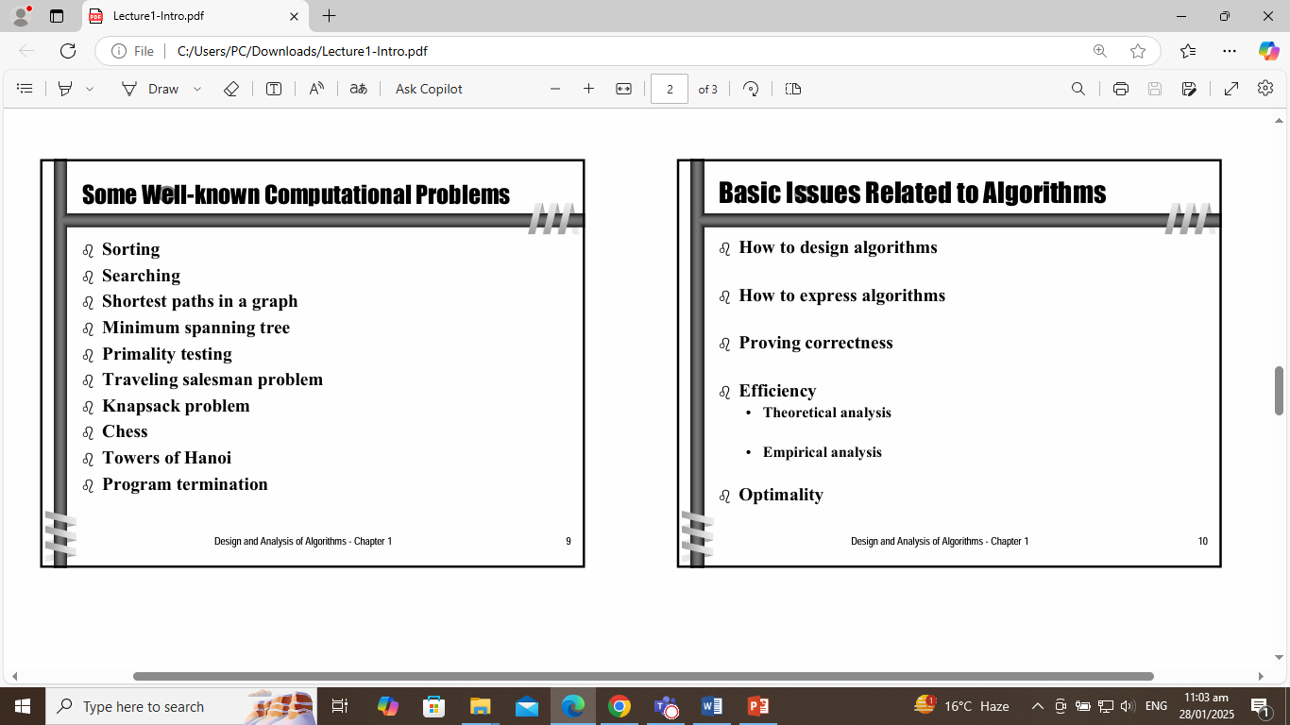

Slide 21
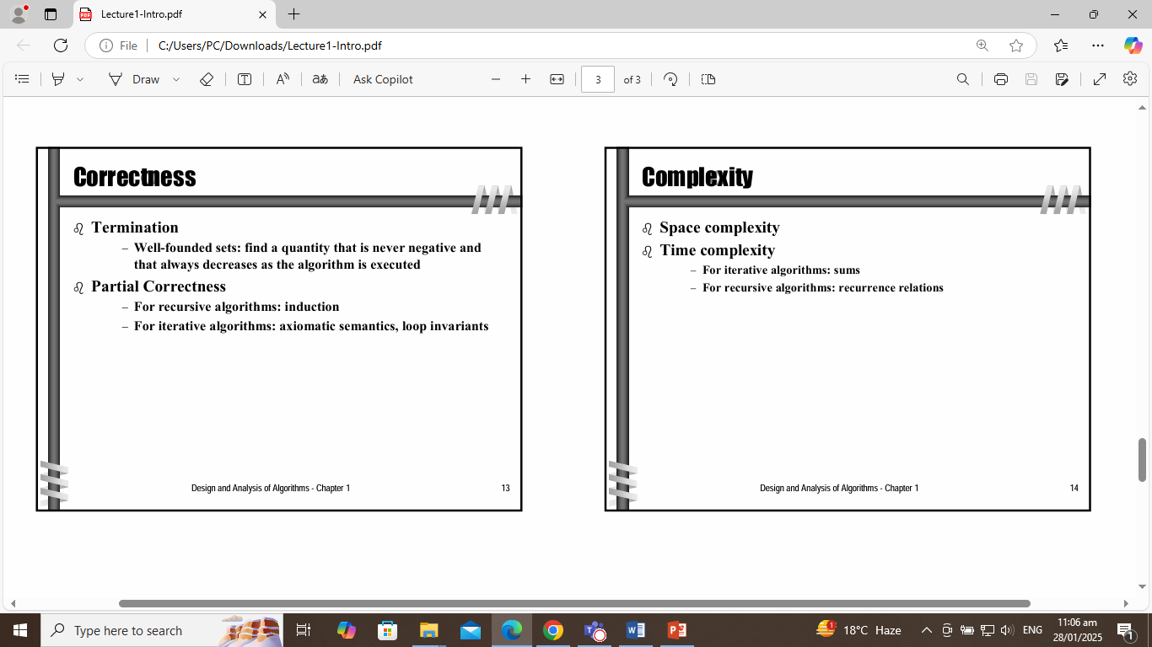

Slide 22
Fundamental data structures
Linear data structures
Array
Linked list
Stack
Queue
Operations: search, delete, insert
Implementation: static, dynamic

Slide 23
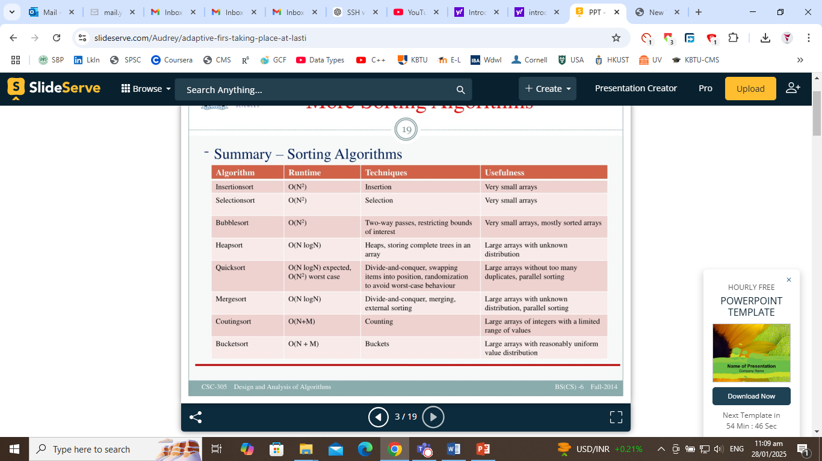

Slide 24
Fundamental data structures
Non-linear data structures
Graphs
Trees : connected graph without cycles
  Rooted trees
    Ordered trees
      Binary trees
Graph representation: adjacency lists,
adjacency matrix
Tree representation: as graphs; binary nodes

Slide 25
Fundamental data structures
Sets, Bags, Dictionaries
Set: unordered collection of distinct elements
Operations: membership, union, intersection
Representation: bit string; linear structure
Bag: unordered collection,
elements may be repeated
Dictionary: a bag with operations search, add, delete

Slide 26
Conclusion
Algorithm classification
    By types of problems
    By design technique
Design techniques
    a general approach to solving problems

